Slide 1
DASHBOARD SALES TRACKING RECORD
SUMIT NERKAR

Slide 2
2.Contents:-
Monthly Revenue……………………….…………………………………………………….. 3-5
Markup Percentage……………………………………………….………………………….. . 6-8
Profit & Total Income………………………..…..…………………………………………...... 9-10
Income (%)…………………………………….……………………………………………… 11-12
Total Revenue …………………………………………………………......................................... 13-14
6. Conclusion.

Slide 3
1.(MONTHLY REVENUE) :-
Monthly product revenue based on
the Area Chart :-
Jan:- $785
Feb :-$ 2382
Mar:- $955
Apr:- $1828
May: $1131
Jun:-$1320
Jul:- $2991
Aug:-$2069
So by analyzing the chart, we can conclude that the revenue for July was higher than for the entire months.

Slide 4
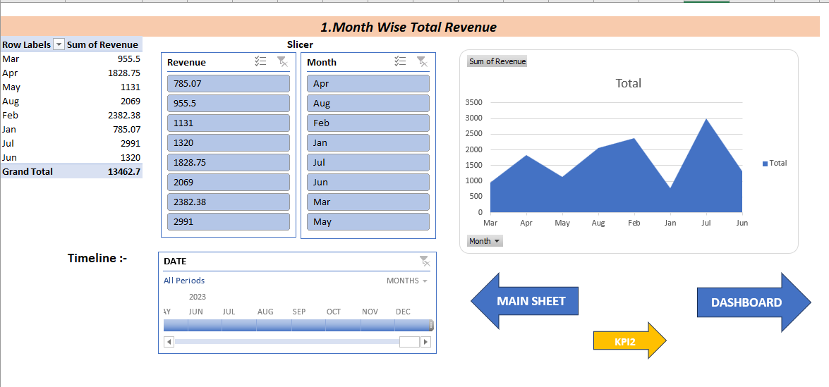
Dashboard creation process snap shot :-
1.Pivot Table
2. Slicer
(Revenue & Month)
3.Timeline
4.Area Chart
(Month vs Revenue)
5.Shortcut Shapes

Slide 5
2.(Markup Percentage) :-
Items per profit in % based on
the Clustered Bar Chart :-
Item 1:- 83%
Item 2:- 87%
Item 3:- 75%
Item 4:- 90%
Item 5:- 95%
Item 6:-100%
Item 7:- 65%
Item 8:- 92%
So by analyzing the chart, we can conclude that the Item 6 has higher profit margin than for the entire Items.

Slide 6
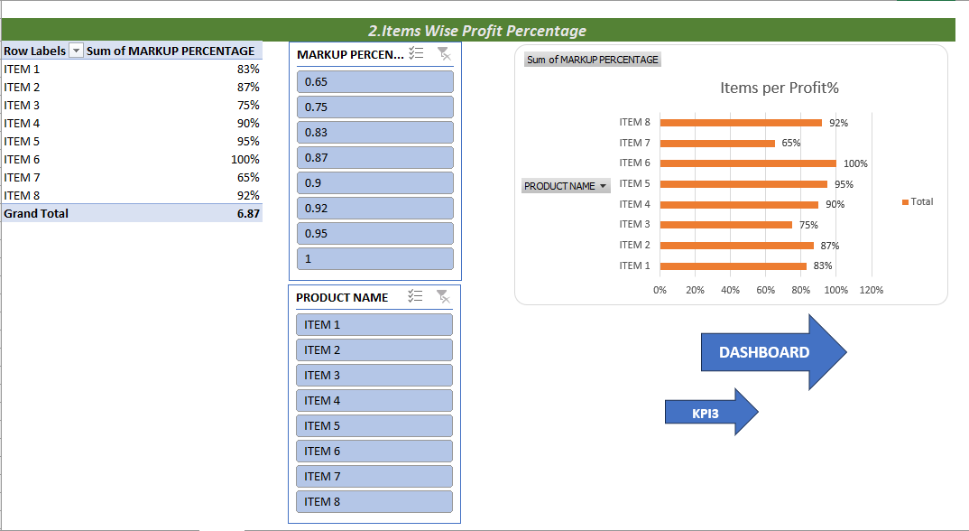
Dashboard creation process snap shot :-
1.Pivot Table
2. Slicer
(Percentage & Product
3.Clustered Bar Chart
(Items vs Markup %
4.Shortcut Shapes

Slide 7
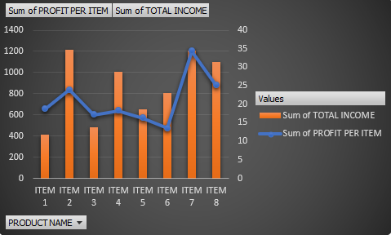
KPI3
Profit and total income (Combo Chart)
Row Labels | Sum of PROFIT PER ITEM | Sum of TOTAL INCOME
ITEM 1 | 18.685 | 411.07
ITEM 2 | 23.815 | 1217.065
ITEM 3 | 17.125 | 479.5
ITEM 4 | 18.25 | 1003.75
ITEM 5 | 16.275 | 651
ITEM 6 | 13.5 | 810
ITEM 7 | 34.35 | 1207.25
ITEM 8 | 25.04 | 1101.76
Grand Total | 167.04 | 6881.395
So by analyzing the chart, we can conclude that item 2 is highest in term of total income and item 7 showed maximum profit per item

Slide 8
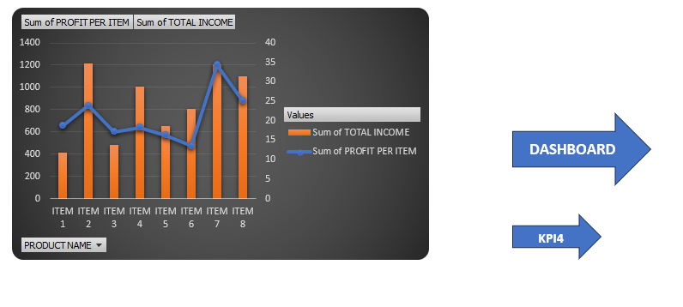
Dashboard creation process snap shot :-
1.Pivot Table
2. Combo chart
Item vs Profit and Total Income
3.Slicer
4.Shortcut Shapes

Slide 9
4. (Income By Percentage) :-
Items per Income By % based on
the Line With Marker Chart
Item 1:- 6.00%
Item 2:- 18.00%
Item 3:- 7.00%
Item 4:- 14.00%
Item 5:- 9.00%
Item 6:-12.00%
Item 7:- 18.00%
Item 8:- 16.00%
So by analyzing the chart, we can conclude that the Item 2 And Item 7 has higher Income Percentage margin than for the entire Items.

Slide 10
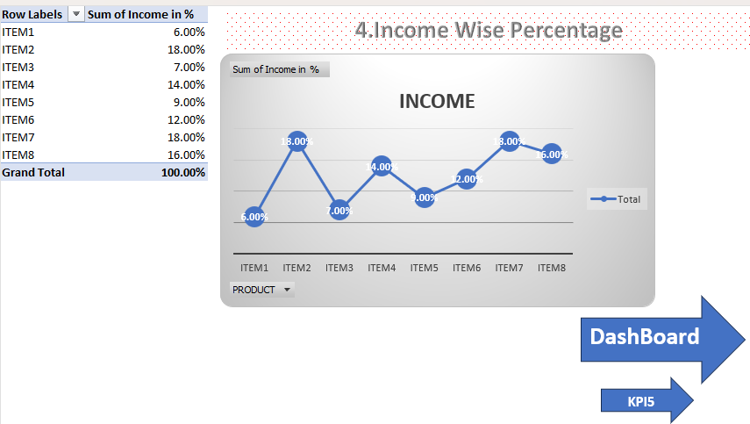
Dashboard creation process snap shot :-
1.Pivot Table
2. Line With Marker Chart
(Items vs Income %)
3.Shortcut Shapes

Slide 11
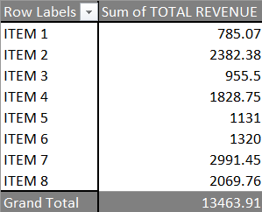
Items vs total revenue
The data is been represented in the donut chart
The data sheet of items vs revenue is linked to the dashboard
The added slicers are connected to show dynamics of the dashboard

Slide 12
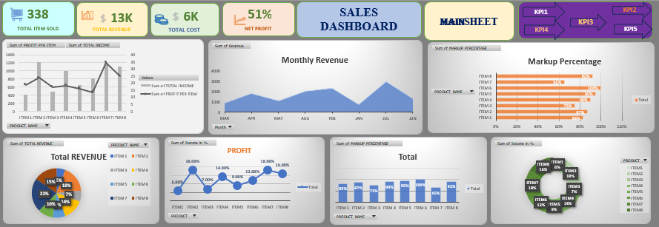

Slide 13
CONCLUSION:-
This sales tracking report provides a detailed breakdown, as well as a broad overview of financial data.
Use the spreadsheet portion of the template to list the Cost per item,
Markup percentage, Quantities sold, Shipping costs, and returns.
The dashboard displays the profit per single item,total income for all items sold, and a Percentage breakdown showing what portion of revenue is attributed to each product.

